Slide 1
C++ Programming:
Problem Solving and Programming
Chapter 9
User-Defined Functions

Slide 2
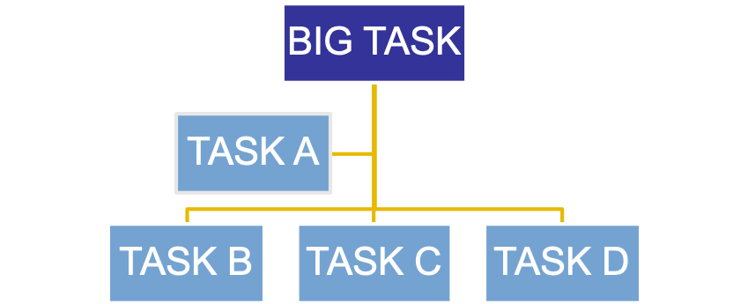
Why Function?
Modular programming enables us to organize a program into small, independent modules/functions that are separately named & individually invoke-able program elements.
Each module performs separate task with a single purpose.

Slide 3
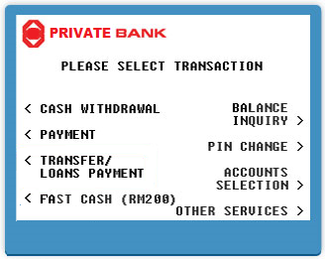
Why Function?
Structured programming enables the large problem to be divided (factored) into main module and its related sub-modules. The division of modules proceeds until the module consists of only the elementary process, which cannot be further divided.
Example:
You wish to build a program that simulates ATM, what are the main modules?
(Hint: Think of the menu on the ATM)
Notes:
e.g. withdrawal, deposit, bank transfer, print statement, change withdrawal limit, change password, check deposit. Deposit can be further divided into deposit cash to own account or other account.

Slide 4
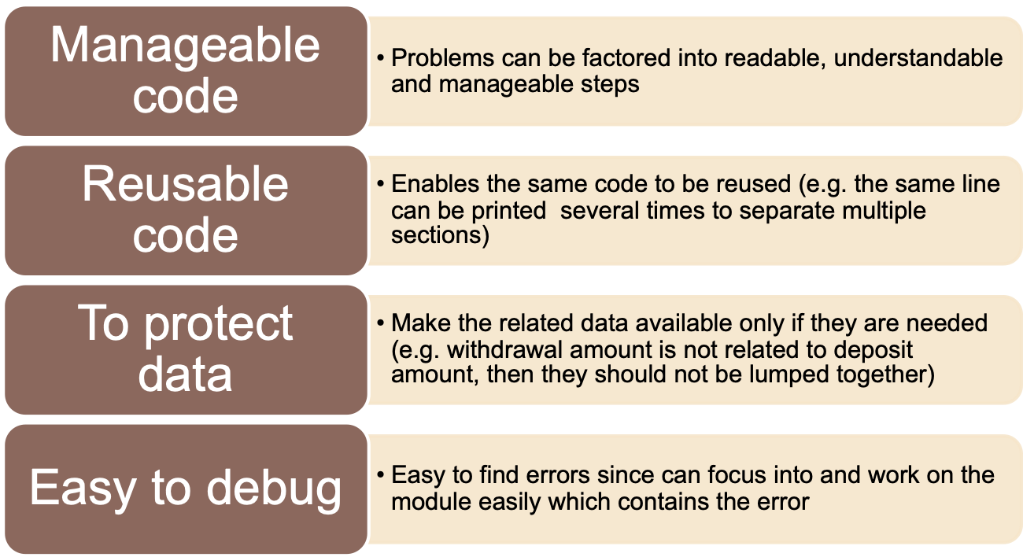
Why Function?

Slide 5
Why Function?
Rules of thumb:
  Contributes to only ONE main task
  Consists of single entry and single exit
  Use meaningful name for the module
    e.g. calculateSalesTax
  May or may not return a value (result)
Can use structure chart to show the hierarchical relationship among all the modules.

Slide 6
Why Function? - Example
Enter phone number: 010-12387654
Enter call usage: 29.50
-------------------------------------------
Phone bill summary
-------------------------------------------
phone number: 010-12387654
User name: Jessie W. Smith
call usage from 1-10-2013 to 31-10-2013
call: RM 29.50
billing: RM 5.00
Total: RM 34.50
Please pay bill by 10-11-2013. Thank you.
Suggest how would you modularize the program above.
Notes:
Your answer can be varied. For example
Create a module called “Search_user_name” to search the name based on phone number.
Create a module called “Calculate_phone_bill” to generate the total bill
Create a module called “print_header” to print the header of the bill
Create a module called “print_deadline” to print the deadline at the end of the bill.
BACS1014 Problem Solving and Programming

Slide 7
Why Function? - Example
Generate_bill
calling module
Read_user_data
Print_bill
called modules /
calling module
Print_header
Search_user_ name
Calculate_phone_ bill
Print_deadline
called modules

Slide 8
Writing a Function
Declaration
void header();
void main() {
header();
}
void header() {
cout << “Function”;
}
Call
Definition
Notes:
AACS1513 Introduction To Programming

Slide 9
Function Declaration / Prototype
  General format for a prototype:
  return-type function_name (arg_type arg);
  return-type : What value the function will return
  function_name : What function will be called
  arg_type arg : What arguments to be passed
  Example:
  double Calculate(int x, int y); OR
  double Calculate(int , int );

Slide 10
Function Definition
Contains the code to complete a task
Made up of function header and function body
Rules of thumb:
Function header: May (or may not) receive some data through its argument list / parameters
Function Body: Used to perform specific actions for the function.
Return Statement: May (or may not) return the function value to the calling module/function.
Data_type Name(argument_list)
{
//process the function_value
return function_value;
}
Notes:
1. argument list is also known as parameter. It is optional, dependent whether or not that you want to pass the value(s) through the parameter.
2. the data (function) type that is returned by the function is dependent on the data that you want to return to the calling module.
3. The data type of the function and the function value must match.
BACS1014 Problem Solving and Programming

Slide 11
Function Definition
TWO types of function:
  Void Functions
    Does NOT return a function value.
    Can receive value from the calling function
  Value-returning Functions
    Will return the function value to the calling module/function.
    Use return statement.
Notes:
1. If you have nothing to return to the calling module, use void function.
2. If you like the function to generate a result and return the result to the calling module, use value-returning function.
3. Both types of functions may accept any number of parameter (or not at all).
BACS1014 Problem Solving and Programming

Slide 12
void function
void Print_result(int);
int main()
{
int res =5 + 3;
Print_result(res);
return 0;
}
void Print_result(int ans)
{
cout << “The answer is “
<< ans;
}
return nothing
function prototype
no return statement
function call
in the calling module/function
in the called module/function
What is the output?
Notes:
The answer is 8
BACS1014 Problem Solving and Programming

Slide 13
Value returning function
int sum_num(int, int);
int main()
{
int res = sum_num(2,3);
cout << res;
return 0;
}
int sum_num(int x1, int x2)
{
int answer= x1 + x2;
return answer;
}
function prototype
arguments /
parameters
function call
return a function value
in the calling module/function
in the called module/function
What is the output?
Notes:
5
BACS1014 Problem Solving and Programming

Slide 14
Function call
  Call a function by using the function name with ( ).
  List parameters inside the bracket ( ) if it is defined.
  Examples:
  Addition(x, y);
  // passing x and y into function to do addition
  Display_Menu();
  // just to perform display in the function
  char grade; …..
  grade = FindGrade(mark);
  // passing mark into function and store the returned grade value

Slide 15
Function call
  Examples:
  cout << calculate(x) ;
  // print the value returned by the function directly rather than assign to a variable
  if (password(name, passw)) OR
  switch (checkGrade(mark)) { … } OR
  while (calculate(x) < 100) { … }
  // use in if, switch and any loop statements to check the value returned by the function

Slide 16
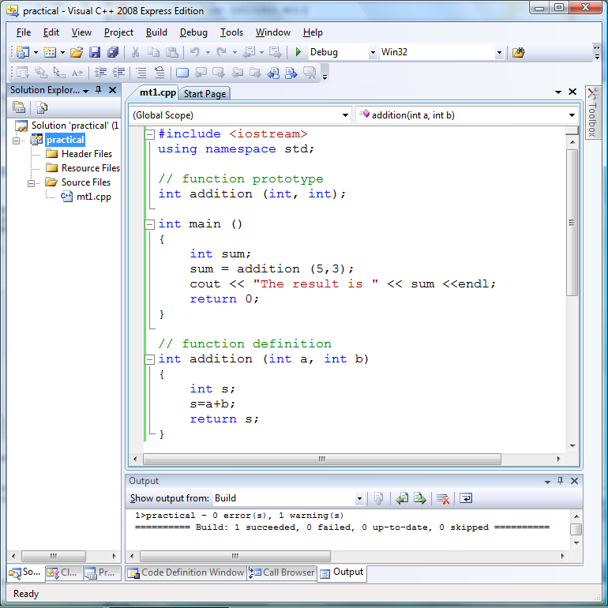
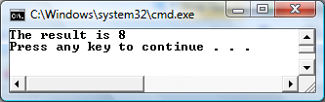
Program using function
function prototype /
function declaration
argument
calling function

Slide 17
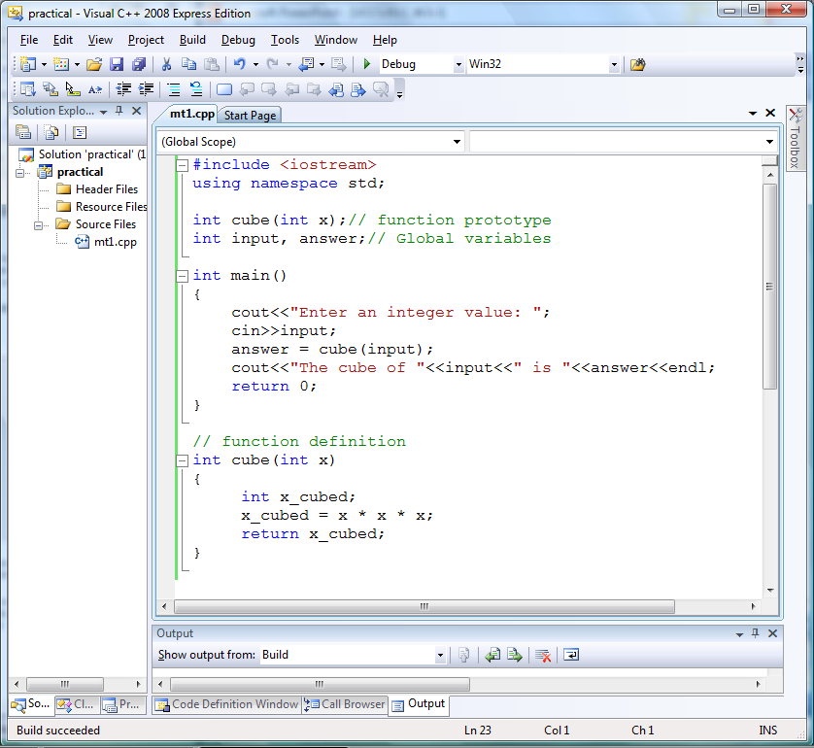

Program using function

Slide 18
Function - Question
Fill in the blank
__①____
int main()
{
double res = multiply(3.2);
cout << res;
return 0;
}
__②__ multiply(_③_ num)
{
_④_ ans =2 * num;
return ans;
}
output
6.4

Slide 19
Function - Question
Fill in the blank
__①____
int main()
{ bool flag = true;
string resp = “ ”;
/*get resp from get_response
based on flag */
__②__
cout << resp;
return 0;
}
__ ③ _ get_response(_ ④ _ F)
{
string response = “ ”;
if (F==true)
response = “Bingo”;
else
response = “Next”;
return response;
}
output
Bingo

Slide 20
Function - Question
Fill in the blank
__①____
int main()
{
string res = “Hello World”;
/*call print_res */
__②__
return 0;
}
_ ③ _ print_res(_④_Result)
{
cout << Result;
}
output
Hello World

Slide 21
Function - Question
Redesign the code below by using modularization and produce the structure chart.
int main(){
int x1, x2, x3, total;
do{
cout << “Enter 3 positive numbers: ”;
cin >> x1 >> x2 >> x3;
} while(x1 < 0 || x2 < 0 || x3 < 0);
total = x1 + x2 + x3;
cout << “The total is “ << total;
return 0;
}
Notes:
#include <iostream>
using namespace std;
int Input( );
int Calculate(int n1, int n2, int n3);
void Output(int total);
int main( ){
int x1, x2, x3, total;
x1 = Input();
x2 = Input();
x3 = Input();
total = Calculate(x1, x2, x3);
Output(total);
}
int Input( ){
int num; // local variable
do {
cout<<"Enter a positive number: ";
cin >> num;
} while(num < 0);
return num;
}
int Calculate(int n1, int n2, int n3) {
return(n1+n2+n3);
}
void Output(int total) {
cout << "The total is " << total;
}

Slide 22
Variable Scope
Local variable
  Declared within the function body
  Not accessible by other functions
Global variable
  Declared outside of any functions in a program
  Accessible to all functions within the program
Notes:
Local variable occupy memory space only while the function is executing. At the moment the function is called, memory space is created for its local variables.
When the function returns, its local variables are destroyed. If at any other time the function is called again, then the same process will restart.
BACS1014 Problem Solving and Programming

Slide 23
Local Variables
int sum_num(int, int);
int main()
{
int res = sum_num(2,3);
cout << res;
return 0;
}
int sum_num(int x1, int x2)
{
int answer= x1 + x2;
return answer;
}
x1, x2 and answer are local variables
res is a local variable
in the calling module/function
in the called module/function

Slide 24
Local Variables - Examples
int main()
{
int a=20, x=20, n=0;
n = calculate(x);
cout << a << endl;
return 0;
}
int calculate(int x)
{
int a; //different from variable a in main( )
a = x * 10;
cout << a << endl;
return a;
}
Output:
200
20

Slide 25
Local Variables - Examples
int main()
{
int x = 20;
cout << "First: " << x << endl;
{
int x = 30;
cout << "Second: " << x << endl;
}
cout << "Third: " << x << endl;
return 0;
}
Output:
First: 20
Second: 30
Third: 20

Slide 26
Global Variables
int sum_num(int, int);
int x1 = 2, x2 = 3;
int main()
{
int res = sum_num();
cout << res;
return 0;
}
int sum_num()
{
int answer= x1 + x2;
return answer;
}
x1 and x2 are global variables
x1 and x2 are global variables
answer is a local variable
res is a local variable
in the calling module/function
in the called module/function

Slide 27
Global Variables - Examples
int calculate(int x);
int a; //global scope
int main() {
int x=20, n=0;
a = 20;
n = calculate(x);
cout << a << endl;
return 0;
}
int calculate(int x) {
a = x * 10; // doesn’t need to declare a as local var.
cout << a << endl;
return a;
}
Output:
200
200

Slide 28
Scope Rules
1. A function name has global scope. Function definitions cannot be nested within function definitions.
int main()
{ cout << sum_num();
return 0;
}
int sum_num()
{
return something;
}
int main()
{
int sum_num()
{
return something;
}
return 0;
}
OK
WRONG!

Slide 29
Scope Rules
2. The scope of a function parameter = local variable declared in the function body
int sum_num(int x1, int x2)
{
int ans = x1 + x2;
return ans;
}
x1, x2 and ans are within the same scope

Slide 30
Scope Rules
3. The scope of global variable (or constant) extends from its declaration to the end of the program (except Rule 5)
int main()
{ cout << globalX; // Error!!!
return 0;
}
int globalX = 100; //declaration
int sum_num()
{ int ans = globalX * 2;
return ans;
} //end of program
Notes:
With one exeption. See Rule 5.
BACS1014 Problem Solving and Programming

Slide 31
Scope Rules
4. The scope of a local variable (or constant) extends from its declaration to the end of the block in which it is declared, includes any nested blocks (except Rule 5)
void Reduce_num()
{ int count= 10; //declaration
while(count > 0)
{ int n = 1;
n = n * count;
count--;
}
}
scope for n
scope for count

Slide 32
Scope Rules
5.The scope of an identifier does not include any nested block that contains a locally declared identifier with the same name (local identifiers have name precedence).
int X = 100; //declaration
int main()
{ cout << X;
cout << sum_num();
return 0;
}
int sum_num()
{ int X = 2;
return X * 3 }
this use global X
this use local X

Slide 33
Scope Rules – Question
Chee Meng wrote his main function as shown below. What mistake has he done?
int sum_num();
int main()
{ int X;
cin >> X;
void print_num()
{ int ans = X * 3;
cout << ans; }
return 0;
}
Notes:
nested function is not allowed
BACS1014 Problem Solving and Programming

Slide 34
Scope Rules - Question
Given the code below, what are the mistakes?
1
2
3
4
5
6
7
8
9
10
11
12
int calculate_tax();
const double rate = 3.1;
void main()
{ double amount, total;
cin >> amount; //assuming amount = 10;
calculate_tax(amount);
cout << total;
}
double calculate_tax()
{ total = amount * rate;
return total;
}
Notes:
Line 1: int calculate_tax(double);
Line 6: total = calculate_tax(amount);
Line 8: Need to pass amount by parameter → double calculate_tax(double amount)
Line 9: int total = amount * rate; (total is a local variable, not global)
BACS1014 Problem Solving and Programming

Slide 35
Scope Rules - Question
Given the code below, what is the output?
int multiply(int); void print_x();
int x = 10;
void main()
{ int y, ans;
cin >> y; //assume y = 5;
ans = multiply(y);
cout << x <<endl << “answer=“<< ans << endl;
print_x();
cout << “x = ” << multiply(1);
}
int multiply(int a)
{ int x = 5;
return x * a;
}
void print_x()
{ x = 100;
cout << “x = ” << x;
cout << endl;
}
Notes:
x=10
answer = 25
x = 100
x = 5
BACS1014 Problem Solving and Programming

Slide 36
Functions with parameters
3 types of functions with parameters:
  Pass by Value
  Pass by Reference
  Pass by Address
Notes:
nested function is not allowed
BACS1014 Problem Solving and Programming

Slide 37
Functions – Pass by Value
A copy of the data is created and placed in a local variable in the called function.
Regardless of how the data are manipulated and changed in the called function, the original data in the calling function are safe and remain unchanged.
This is the preferred passing technique because it protects the data.

Slide 38
Functions – Pass by Value
#include <iostream>
using namespace std;
void fun ( int x);
int main (void)
{
int a=5;
fun (a);
cout << a;
return 0;
}
a 5
x 5 ←only a copy
prints 5 (not affected by the
function fun)
void fun (int x) {
x = x + 3;
}

Slide 39
Functions – Pass by Reference
Links the variable identifiers in the calling function to their corresponding parameters in the called function.
Any reference to a parameter is therefore the same as a reference to the variable in the calling function.
When the called function changes a value, the variable in the calling function also changed
we need to use a reference variable (&) as the parameter in the function.

Slide 40
Functions – Pass by Reference
# include <iostream>
using namespace std;
void fun ( int &x);
int main (void){
int a=5;
fun (a);
cout << a;
return 0;
}
a
x
reference
variable
← no address operator ‘&’
← prints 8
void fun (int &x)
{
x = x + 3;
}
← Does not require ‘*’

Slide 41
Functions – Pass by Address
Use pointers
& (address operator): used to pass an address
* (indirection operator): used to store data at / to get data from an address

Slide 42
Functions – Pass by Address
# include <iostream>
using namespace std;
void fun ( int *x);
int main() {
int a=5;
fun (&a);
cout << a;
return 0;
}
a
Dereference
x ←address
  (pointer)
← & : address operator
← prints 8
void fun (int *x)
{
*x = *x + 3;
}
← Requires ‘*’
to dereference

Slide 43
Exchanging Two Variables using Pass by Reference functions
void exchange (int &num1,int &num2);
int main (void) {
int a, b;
……
exchange (a, b);
……
return 0;
}
a b
num1 num2
(num1 and num2 are reference variables) temp
  ↑
type includes an ampersand
  ↑
  No address operators
void exchange (int &num1, int &num2)
{
int temp;
temp = num1;
num1 = num2;
num2 = temp;
}
← no ‘*’ is required

Slide 44
Exchanging Two Variables using Pass by Address functions
void exchange ( int *num1, int *num2);
int main (void)
{
int a, b;
……
exchange (&a, &b);
……
return 0;
}
a b
Dereferences
num1 num2
(num1 and num2 are addresses)
temp
  ↑
type includes an asterisk
  ↑
  address operators
void exchange (int *num1, int *num2) {
int temp;
temp = *num1;
*num1 = *num2;
*num2 = temp;
}
← Indirection
operator ‘*’ is used for dereferencing.

Slide 45
Functions Overloading
Overloading a function
  Several functions with the same name, but different parameter lists
Parameter types determine which function will execute. Must provide the definition of each function.
Can overload two or more functions by:
  Having a different number of parameters
  Having the same number of parameters, but
    Parameter types should be in different order
    At least one parameter type should be different

Slide 46
Functions Overloading - Example
// overloaded function
#include <iostream>
using namespace std;
int divide (int a, int b) {
return (a/b);
}
float divide (float a, float b)
{
return (a/b);
}
int main ()
{
int x=5,y=2;
float n=5.0,m=2.0;
cout << divide (x,y);
cout << "\n";
cout << divide (n,m);
cout << "\n";
return 0;
}
2
2.5

Slide 47
//Function overloading
#include <iostream>
using namespace std;
void swap (char &x, char &y)
{ char t;
t=x;
x=y;
y=t; }
void swap (int &x, int &y)
{ int t;
t=x;
x=y;
y=t; }
void swap (float &x, float &y)
{ float t;
t=x;
x=y;
y=t; }
int main()
{ char ch1, ch2;
cout << "Enter two characters : ";
cin >> ch1 >> ch2;
swap (ch1, ch2);
cout << "After swapping : " << ch1
<< " " << ch2 << endl;
int a, b;
cout << "\nEnter two integer numbers : ";
cin >> a >> b;
swap (a, b);
cout << "After swapping : " << a
<< " " << b << endl;
float x, y;
cout << "\nEnter two floating point numbers : ";
cin >> x >> y;
swap (x, y);
cout << "After swapping : " << x << " "
<< y << endl;
return 0; }

Slide 48
Applications of Functions/Modules
Menus
Interactive program that displays a set of options to the user.
Single-level menu: Selection from only one menu.
Multi-level menu: selection of one option leads to another menu with further, refined selections.

Slide 49
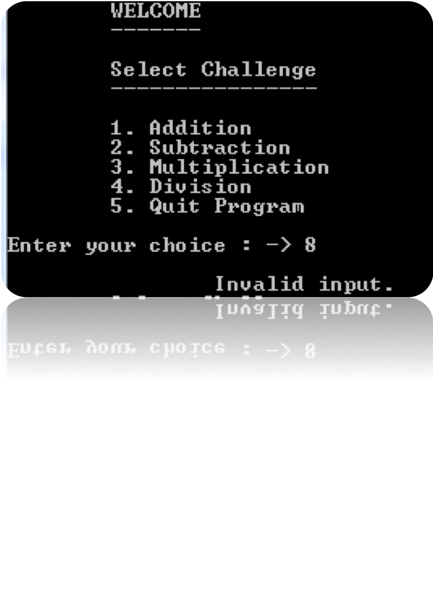
Menus – Rules of Thumb
Menus should always have a “quit” choice.
It is important to keep track of bad user input

Slide 50
Single Level Menu
Given the main program as follows, write the C++ function called “displayMenu” to display the menu of previous slide.
void displayMenu() {
cout << “Select Challenge\n”;
cout << “----------------\n”;
cout << “1. Addition\n”;
cout << “2. Subtraction\n”;
cout << “3. Multiplication\n”;
cout << “4. Division\n”;
cout << “5. Quit Program\n”;
}
Notes:
void Display_menu(){
int choice;
do{
cout << "\tSelect Challenge\n"
<< "\t----------------\n\n";
cout << "\t1. Addition\n"
<< "\t2. Subtraction\n"
<< "\t3. Multiplication\n"
<< "\t4. Division\n"
<< "\t5. Quit Program\n";
cout << "\nEnter your choice : -> ";
cin >> choice;
switch(choice)
{
case 1:
Addition();
break;
case 2:
Subtraction();
break;
case 3:
Multiplication();
break;
case 4:
Division();
break;
case 5:
break;
default:
cout << "\n\t\tInvalid input.\n";
}
}while(choice!=5);
BACS1014 Problem Solving and Programming

Slide 51
Single Level Menu
void Addition();
void Subtraction();
void Multiplication();
void Division();
void main() {
int choice;
do{
  cout << "\tWELCOME\n"
  << "\t-------\n\n“;
  displayMenu();
  cout << “Enter your choice: → ”;
  cin >> choice;
switch(choice) {
case 1: Addition();
break;
case 2: Subtraction();
break;
:
default: cout<< “Input
invalid!”;
} while (choice!= 5);
}
Remark: Use do while loop and switch statement for handling menu processing
Notes:
void Display_menu(){
int choice;
do{
cout << "\tSelect Challenge\n"
<< "\t----------------\n\n";
cout << "\t1. Addition\n"
<< "\t2. Subtraction\n"
<< "\t3. Multiplication\n"
<< "\t4. Division\n"
<< "\t5. Quit Program\n";
cout << "\nEnter your choice : -> ";
cin >> choice;
switch(choice)
{
case 1:
Addition();
break;
case 2:
Subtraction();
break;
case 3:
Multiplication();
break;
case 4:
Division();
break;
case 5:
break;
default:
cout << "\n\t\tInvalid input.\n";
}
}while(choice!=5);
BACS1014 Problem Solving and Programming

Slide 52
Multi Level Menu
This is good to be used when
  there are too many options
    users would get confused by too many choices
  screen is too crowded and not organized
    crowded screen reduce readability and error prone

Slide 53
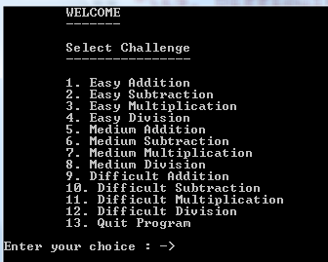
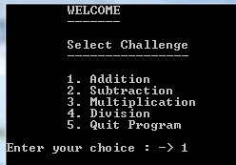
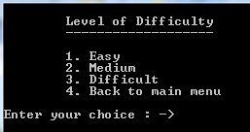
Multi Level Menu
Option 1
Option 2
Which one better?
Notes:
BACS1014 Problem Solving and Programming

Slide 54
Multi Level Menu - Exercise
Write the C++ program for the menu functions at previous slide.
Notes:
BACS1014 Problem Solving and Programming

Slide 55
Input Validation
Incorrect user entries are the most common errors.
Failing to account for valid responses will lead to runtime errors.
Questions to ask:
  Is the user input within the given range?
  Does the user input follow desired format?
  Is the user input reasonable?

Slide 56
Input Validation - Exercise
Consider the program below. Suggest the potential bad user data for each field.
Fill in the form
---------------------
Name:
Age:
Email:
Indicate your satisfaction of Product A:
<1-Satisfied; 2-Somewhat satisfied; 3-Not satisfied> : →

Slide 57
Input Validation - Exercise
Consider you would like to validate the AGE entered by the user, which must fulfill the following criteria:
  It must be a number
  It must be 18 or above, and below 80.
  You should display appropriate error message.
Write a Pseudocode to represent your solution
Notes:
bool validAge = false;
string Age;
int intAge;
do{
cout << "\tAge: ";
getline(cin, strAge);
if(isNumber(strAge))
{
intAge = atoi(strAge.c_str());
if(intAge < 18 || intAge > 80)
cout << "\tinvalid age. You are either too old or too young\n";
else
validAge = true;
}
else
cout << "Age must be a number\n";
}while(!validAge);
BACS1014 Problem Solving and Programming

